Slide 1
MDA project
AED analysis and placement

Slide 2
General approach and plan
Find underperforming AED’s and reallocate
Criteria for underperformance
Finding where to reallocate
Synthetic data
Cost + budget implementation
Test performance
General approach: rational values and logical methods

Slide 3
Four steps in analysis
Initial data inspection
Data cleaning and handling
Exploratory analysis
Main analysis

Slide 4
Main analysis
Which data to use
Which distance to use
Detecting underperformance of AED’s
Budget – cost implementation
Synthetic data
Reallocating the AED’s
Results

Slide 5
Which data to use
All cardiac cases used (instead of cardiac arrests specifically)
AED might be useful for all types
Distribution is similar
More data => better (56284 versus 6429 datapoints, almost X10)
Less subject to randomness

Slide 6
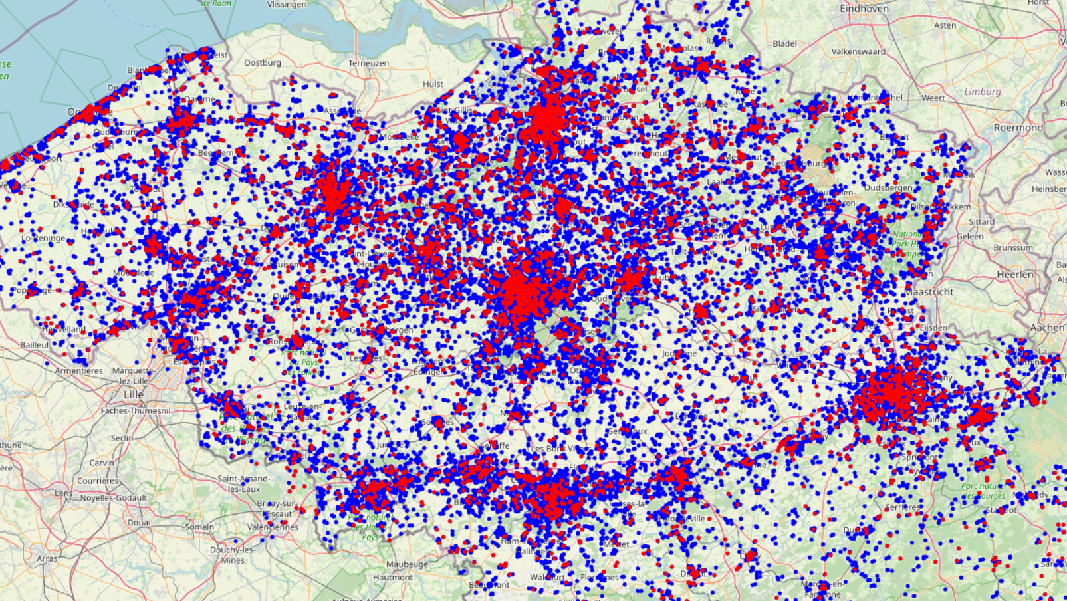

Slide 7
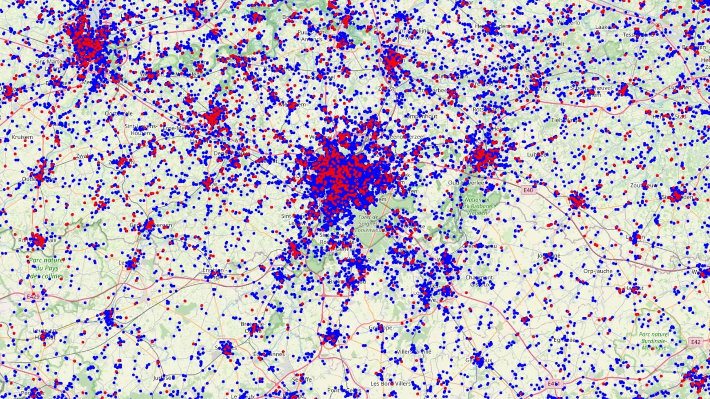

Slide 8
Distance to use
Person can survive for 3 minutes (contact stakeholder)
Distance in meter: X = (((10 000 / 60) * minutes) / 1.15) / 2
10 000 / 60: meters per minute
Minutes: 3 minutes
/1,15: not a straight line
/2: go back and forth

Slide 9
Already saved
98 instances already reached within this time by professionals => these do not need an AED

Slide 10
Underperformance AED’s
The cardiac arrest is already reached within 3 minutes by a professional
It takes longer than 3 minutes to reach the AED from the spot of the cardiac arrest (summing both ways, so the actual distance itself is 1.5 minutes from the spot)
There is already another AED closer to the cardiac arrest

Slide 11
Rule 1
Already applied by excluding all cardiac arrests that were reached by a professional from the analysis
An AED cannot be close to a cardiac arrest that is not present in the dataset

Slide 12
The other 2 rules
Look at the cardiac arrests, not the AED’s!
Each cardiac arrest should only have one single AED it is closest to
Use a table, containing id of AED, id of cardiac arrest and the distance between the two

Slide 13
3 possible situations
There is one single AED within a radius of X near the cardiac occurrence
There are no AED’s within a radius of X near the cardiac occurrence
There are multiple AED’s within a radius of X near the cardiac occurrence

Slide 14
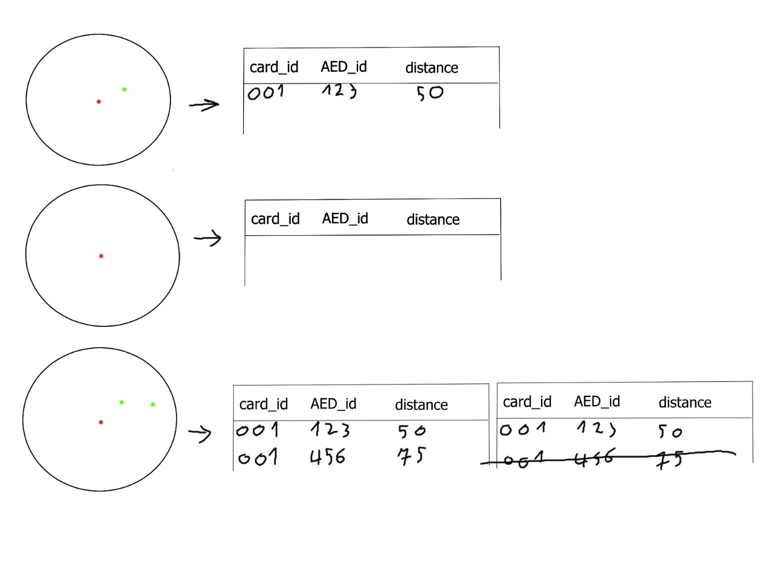

Slide 15
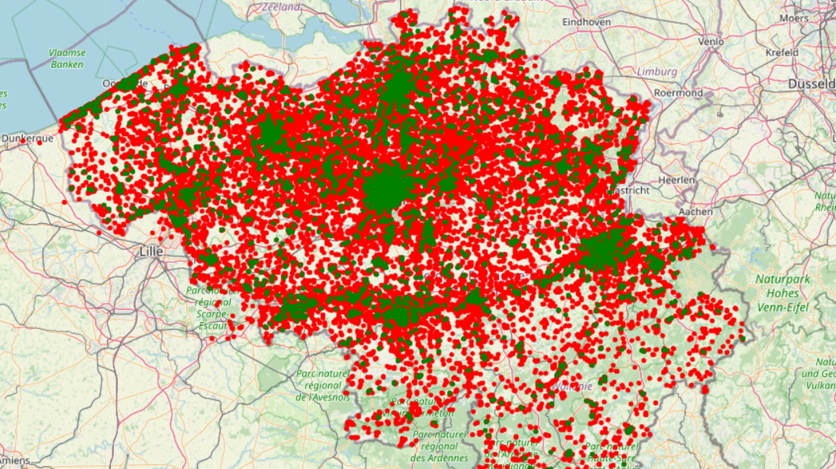

Slide 16
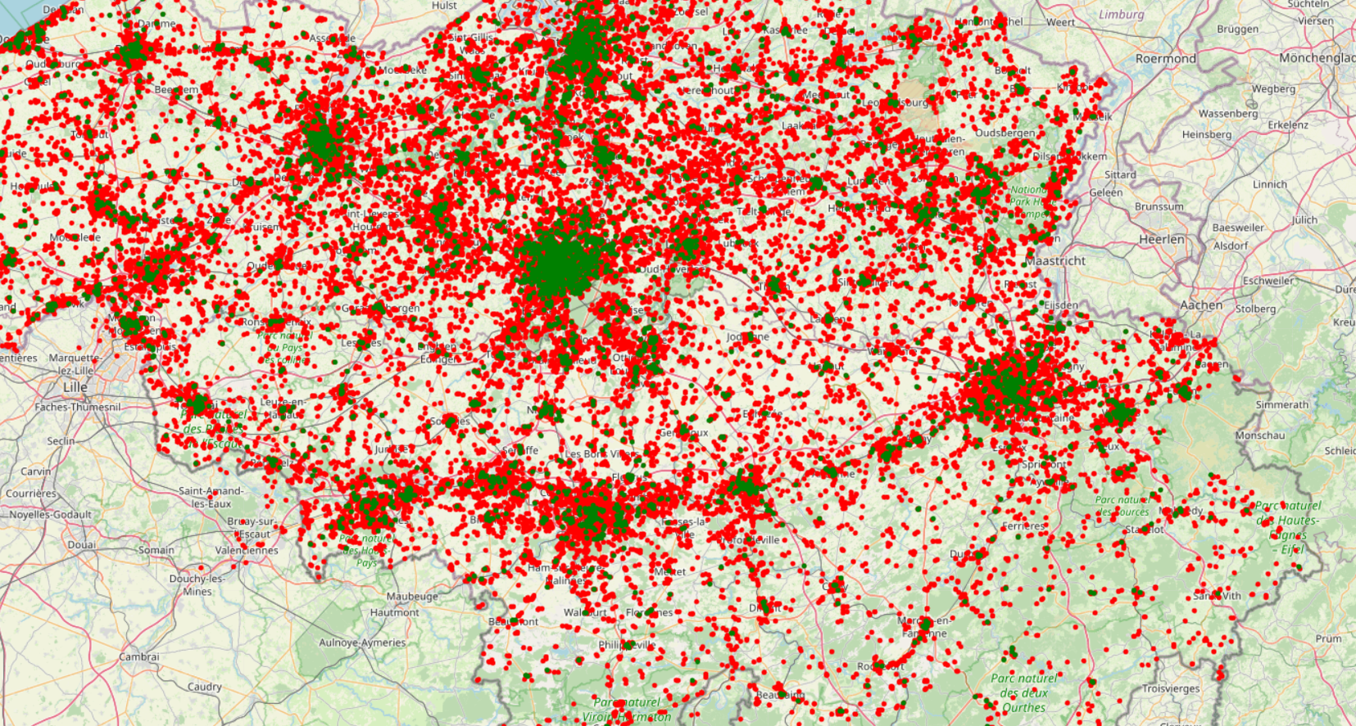

Slide 17
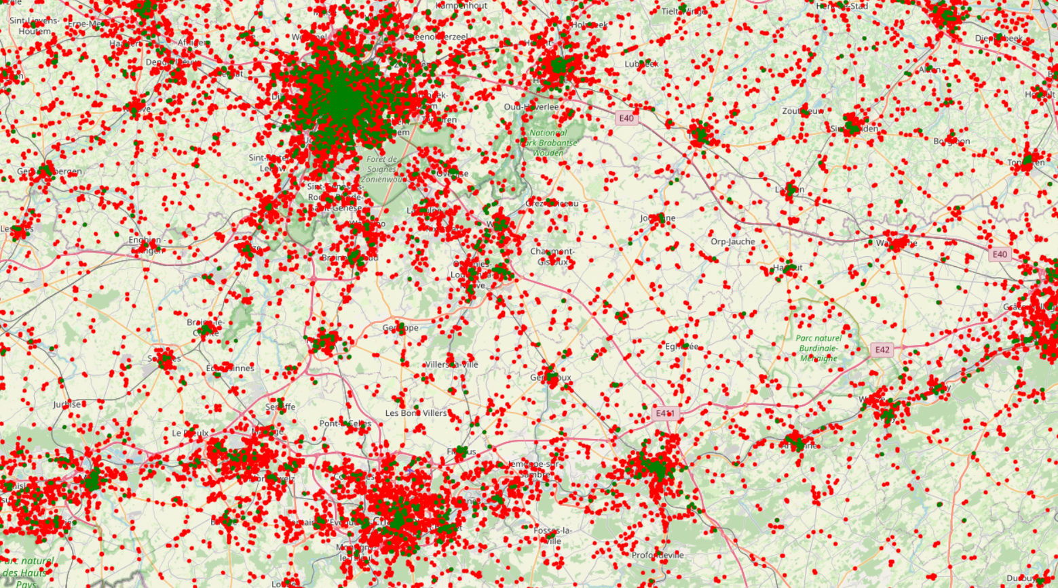

Slide 18
Budget – cost implementation
Main analysis: no budget constraints
Implementation makes budget constraints possible (i.e. fixed number of AED’s to move) => move Y worst AED’s
Amount of AED’s to move = total AED’s minus valid AED’s
Use distance X as parameter in binary search, using function defined earlier to get the amount of valid AED’s

Slide 19
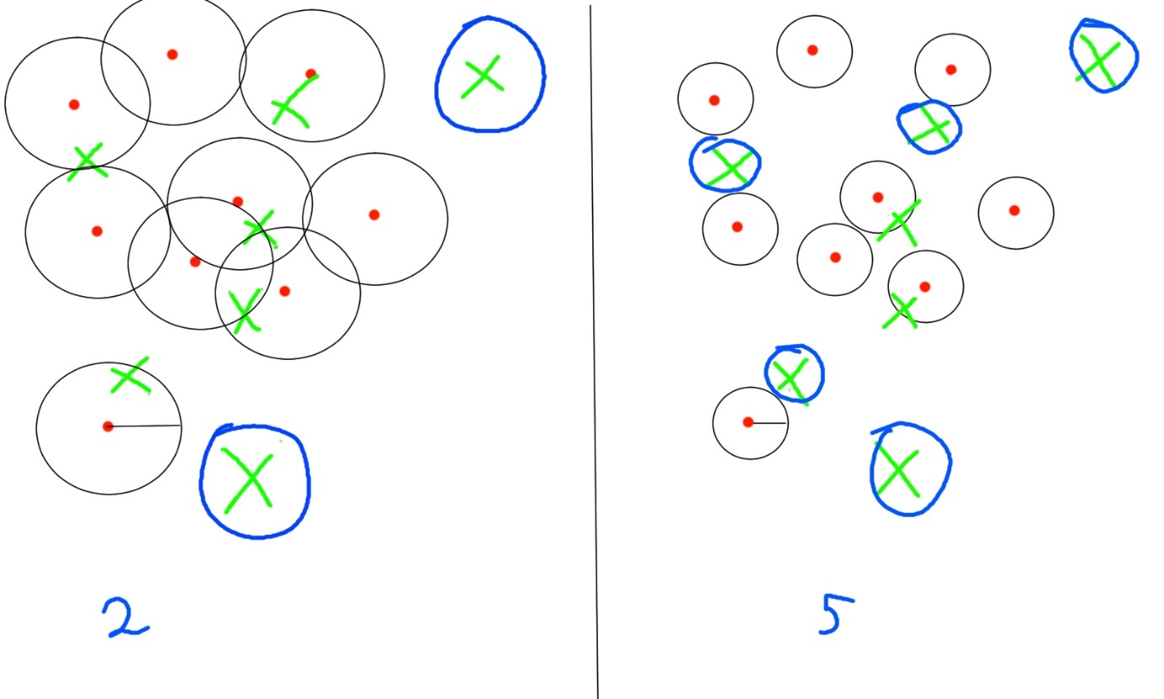

Slide 20
Budget – cost implementation
The worst performing AED’s will be selected
Note: X loses it’s interpretation; it is just a parameter here
For all further analyses: still use the original value of X

Slide 21
Synthetic data
Avoid overestimation of the results of placing the invalid AED’s
Observed instances: exact location more or less random
2 methods used to generate: K-means based, and uniform perturbation based

Slide 22
Placing the AED’s
Big area to cover
Limited amount of AED’s
Clustering solution is used. 2 rules to find valid clusters
Rule 1: density needs to be above a certain threshold
Rule 2: minimum number of instances per cluster

Slide 23
Clustering: DBSCAN
makes use of both our rules
Caveat: haversine distance cannot be used directly
Approximation of distance X in degrees is used instead

Slide 24
AED assignment
Amount of AED’s assigned to each cluster: proportional to the size of the cluster

Slide 25
Exact locations AED
Small clusters (only 1 AED to be placed: centroid of cluster
Bigger clusters (more than 1 AED): maximum coverage of cluster

Slide 26
Maximum coverage
Future location of occurrence => random, cannot be known
Try to cover as much area as possible in the cluster

Slide 27
Maximum coverage algorithm
Greedy: maximize for each individual step
Can easily deal with the complex shapes of clusters
Generate random points, using perturbation of original points in cluster
Starting point: bottom most point (lowest latitude value)

Slide 28
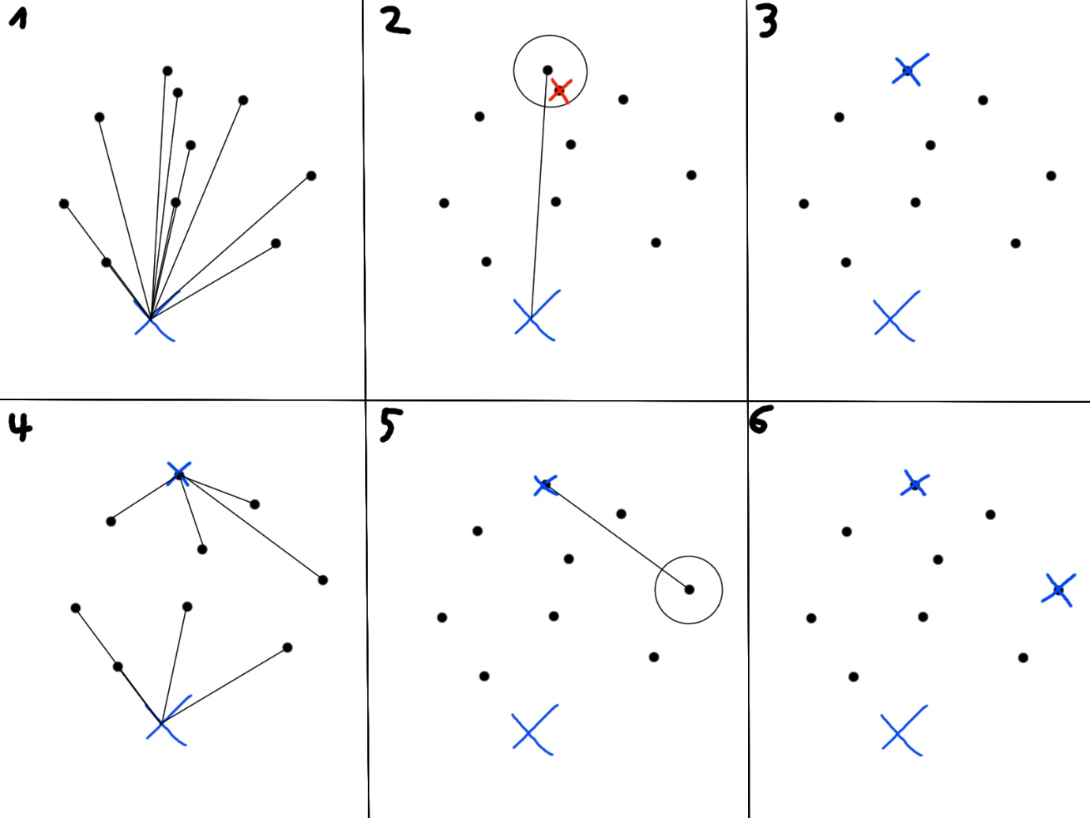

Slide 29
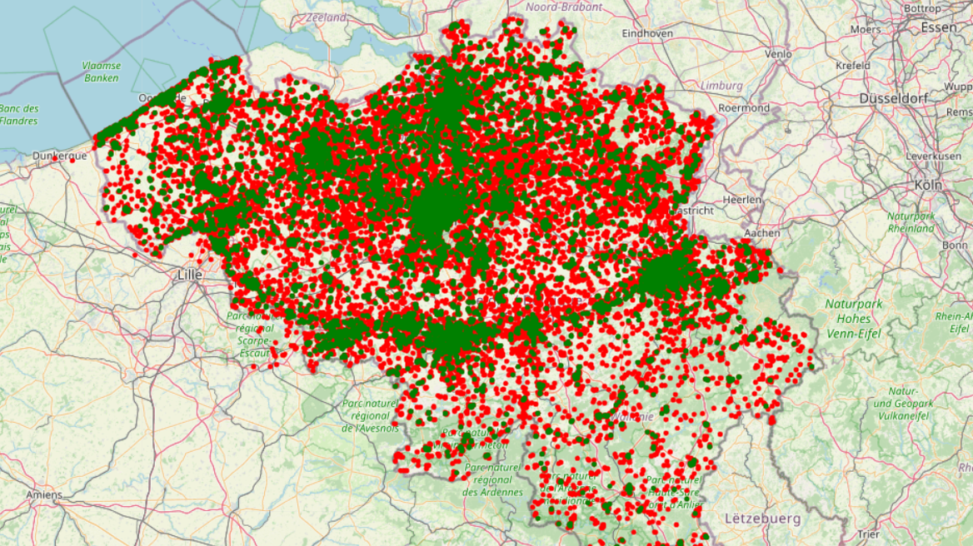

Slide 30
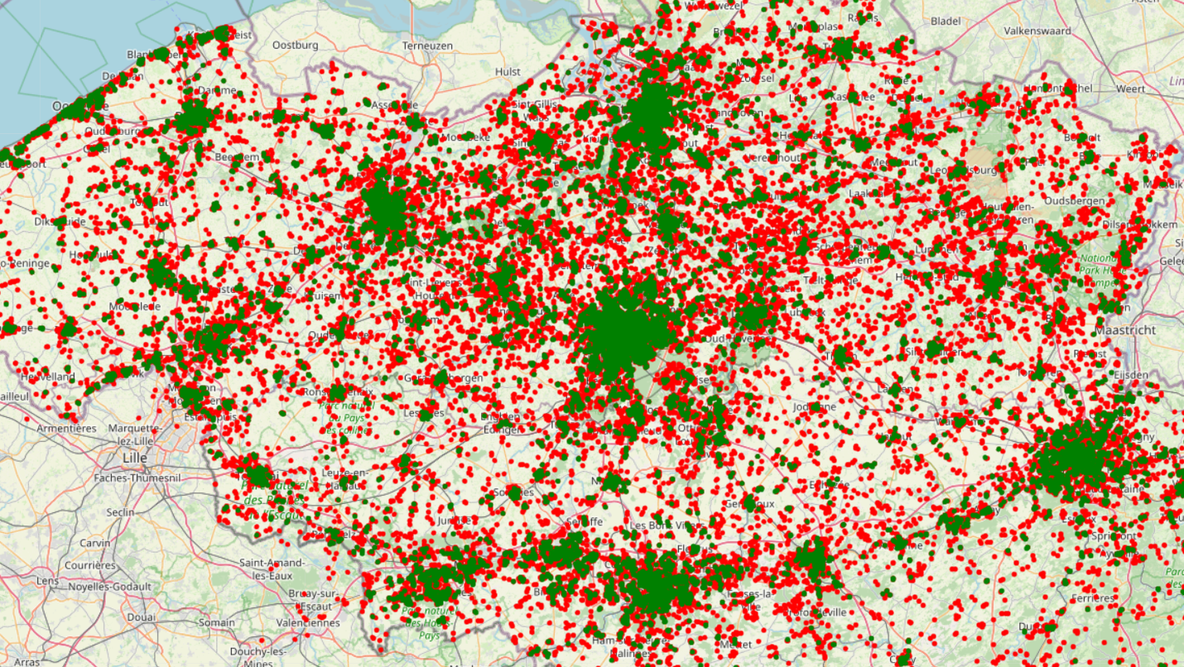

Slide 31
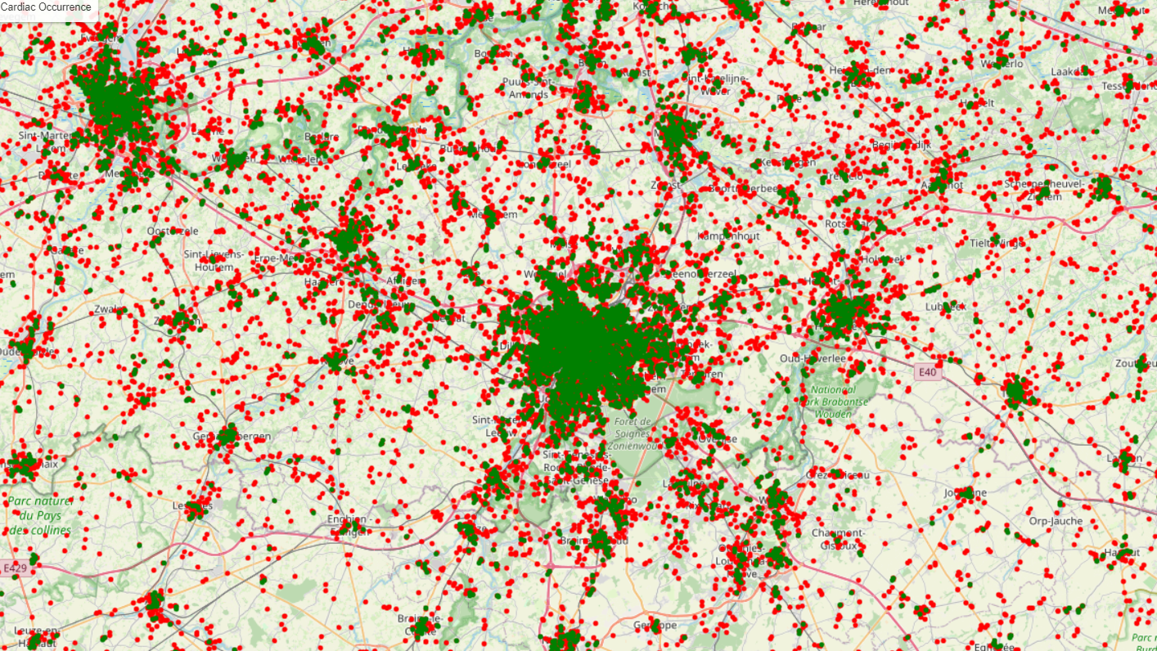

Slide 32
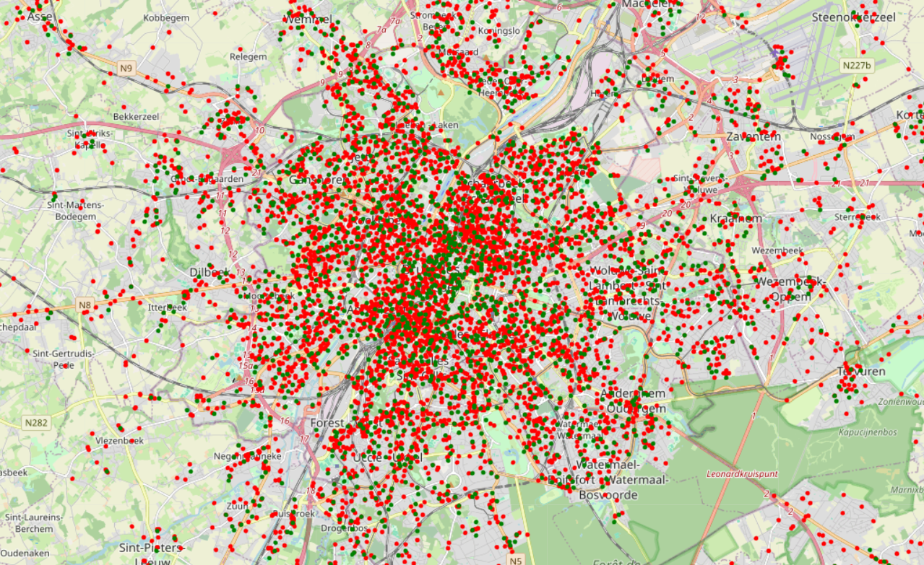

Slide 33
